Slide 1



SECUREFIN
MohanKumar A,
Ashwath Kumar U

Slide 2

INTRODUCTION
In a traditional lending process, people require intermediaries like a loan officer, banks, underwriter, and loan processor to build the trust. But adding middlemen and regulations to the process of lending leads to the high fees. Then came the concept of collateral where one had to keep their belongings as security to get a loan. But, with time the centralized nature of these third parties made the system very complex due to extra layers of regulations and time-consuming manual process leading to huge costs on consumer’s part. To tackle these issues, people are looking towards blockchain technology as it is built on the lending platform, providing a trustless, decentralized and secure platform for lending practices. Blockchain technology-based lending provides a solution for this as it is based on a lending platform and can make the entire process smoother and safer leading to obsoletion of traditional banking system and third parties. A borrower sitting in any part of the world can access the loan market and lenders can bid to deliver it due to the decentralized nature of blockchain technology.

Slide 3
CURRENT STATE
People are moving away from traditional lending procedures to digital lending because of the awful amounts of time taken to process a loan and the heavy paperwork involved with it.
Small and medium-sized enterprises (SMEs) account for more than 85% of net job generation in developing countries. However, SME financing is required since 50% of SMEs in 128 countries are credit constrained.
Small and medium-sized enterprises (SMEs) account for more than 85% of net job generation in developing countries. However, SME financing is required since 50% of SMEs in 128 countries are credit constrained.

Slide 4

PROBLEM DESCRIPTION
Lack of trust:
Banks do not trust the borrower’s (SMEs, entrepreneurs) details as it is often tampered and changed by the user to get loans by submitting invalid or fake reports or credit history.
Time consuming:
Lending procedures are tedious and time-consuming. There is a large amount of documentation that must be completed, and manual evaluation and verification might take several days. To satisfy the expanding demands of the business, the enterprises must keep a strong workforce, which adds to the costs.
Collateral Restrictions:
Collateral requirements on a loan contract are particularly significant for SMEs compared to large firms because they lack Good Credit history or to pledge as collateral to the banks, which may cause SMEs to be credit rationed .

Slide 5

SOLUTIONS
Increased Trust:
Secure Fin Platform helps the participants involved in the lending process, such as regulators and auditors, easily verify identities and track previous transactions stored on the blockchain. So that, the bank’s trust on the borrower increases.
Faster Verification:
By storing a customer's KYC paperwork on the blockchain, financial institutions can accomplish this task quickly. Other institutions can use the same KYC in this way without having to repeat the entire procedure. Additionally, the dependability of the data on the blockchain is quite high because it cannot be altered.
Asset as a collateral:
Equipment can be used as collateral to secure a loan. if the loan amount is relatively low, equipment or inventory may be a great option to use as collateral.

Slide 6


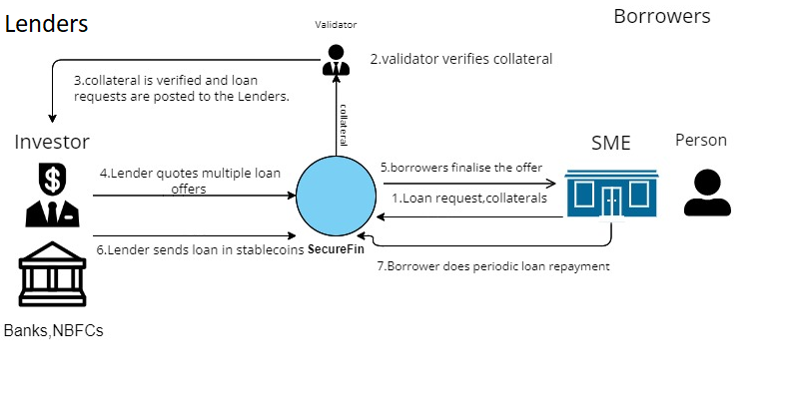
Solution Architecture

Slide 7
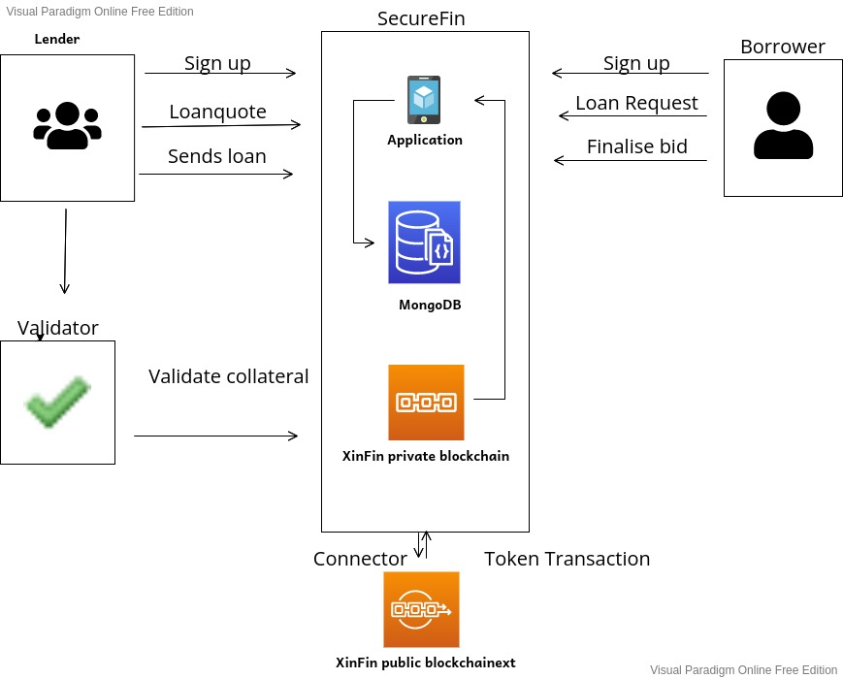
TECHNICAL DIAGRAM

Slide 8
SOLUTION IMPLEMENTATION
People who are willing to borrow or lend need to open their accounts on a lending platform.
Lenders provide information about their type of investment, bank account (crypto account or normal bank account) and personal information.
Borrowers provide personal information like identity proof, income proof and some other legal documents. As collateral ,they might be required to provide assets or invoices .The collateral is verified by a validating agency and the collateral documents are stored on a blockchain.
Once the collateral is verified and valued, the loan request is posted to the lenders. Lenders quotes multiple loan offers with varied rate of interest.
Borrowers Finalize the loan offers provided by the lender. Lenders provides the funds in stable coins.
Borrower makes the periodic repayment of the loan and gets rewarded in SF tokens.
All the Transactions are hashed into a private blockchain.

